Slide 1
Group 7 Final Project
Analytical analysis of President Election
Group Members:
Sun Pil Howang
Chengkai Ji
Hrolfur Sveinsson
Peijia Wu
Yihang Zhao
Notes:
For the presentation, divide the time into three main segments or asks: (1) to introduce the project and data (2) to explain your schema design and (3) go over your analytical questions and findings. In your code, you will need to answer all the analytical questions that we agreed on during our earlier sponsor meeting. However, during the presentation, you can pick 3 or 4 questions (time permitting). You don't have to go over all the six questions. Arrange with your group members next week to do a dry run so your group is prepared.

Slide 2
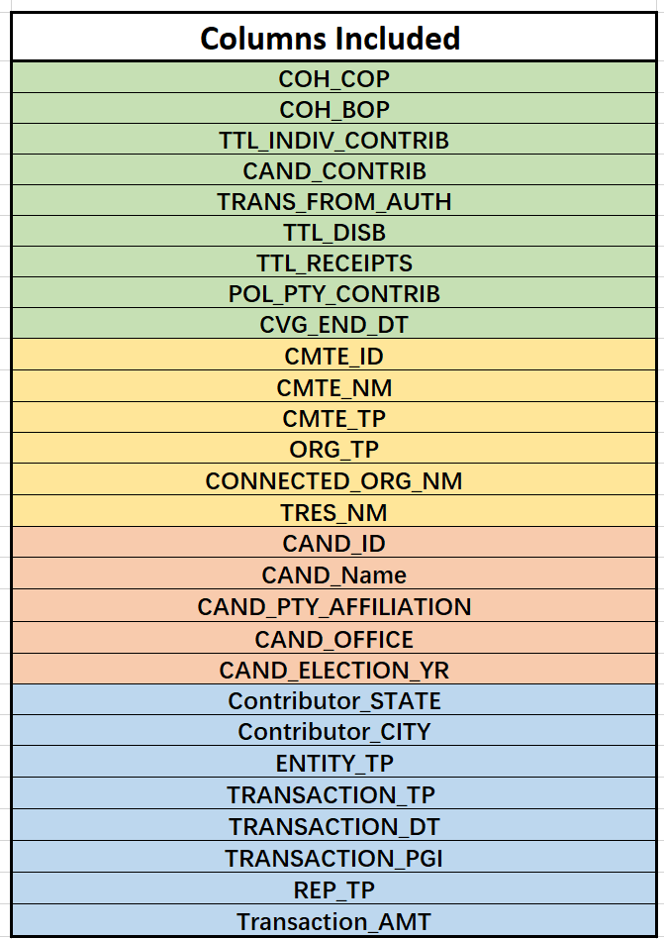
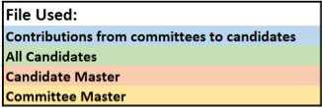
Project and Data

Slide 3

Project and Data
Delete columns
Rename columns
Join tables
Union 2016 and 2020

Slide 4
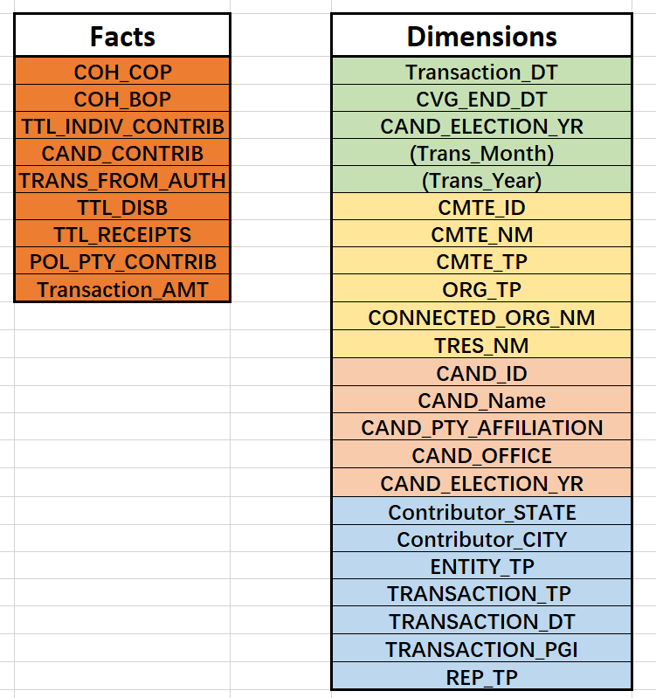
Project and Data
Date
Committee
Candidate
Contribution

Slide 5
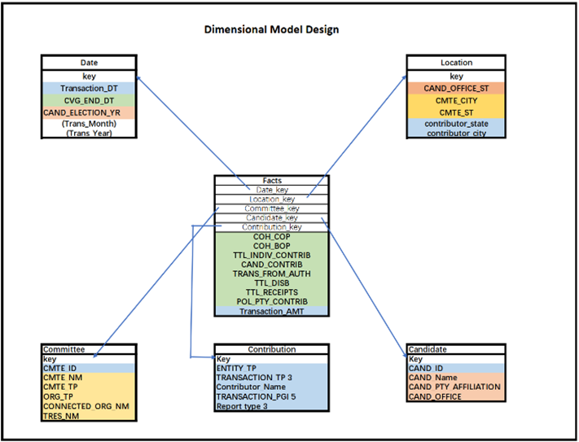

Slide 6
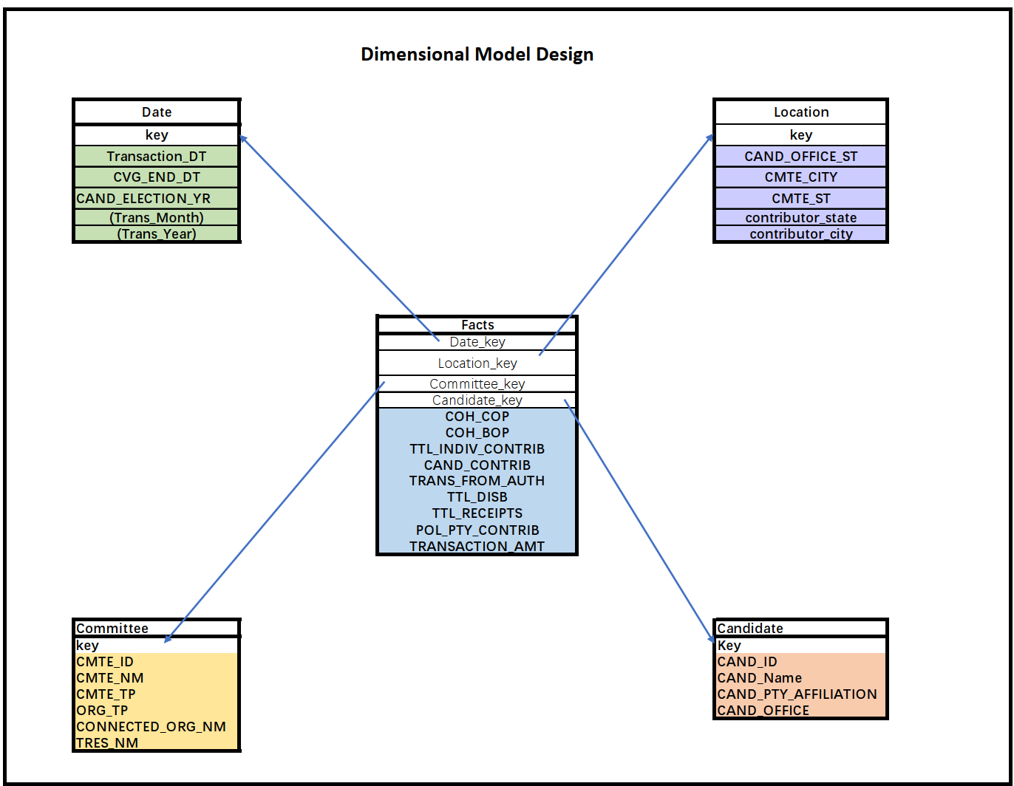
Dimensional Design

Slide 7
Analytical Questions and Findings
What are the names of the top 5 committees which contributed the single highest amount to Joe Biden and Donald Trump in 2020, and Hillary Clinton and Donald Trump in 2016?

Slide 8
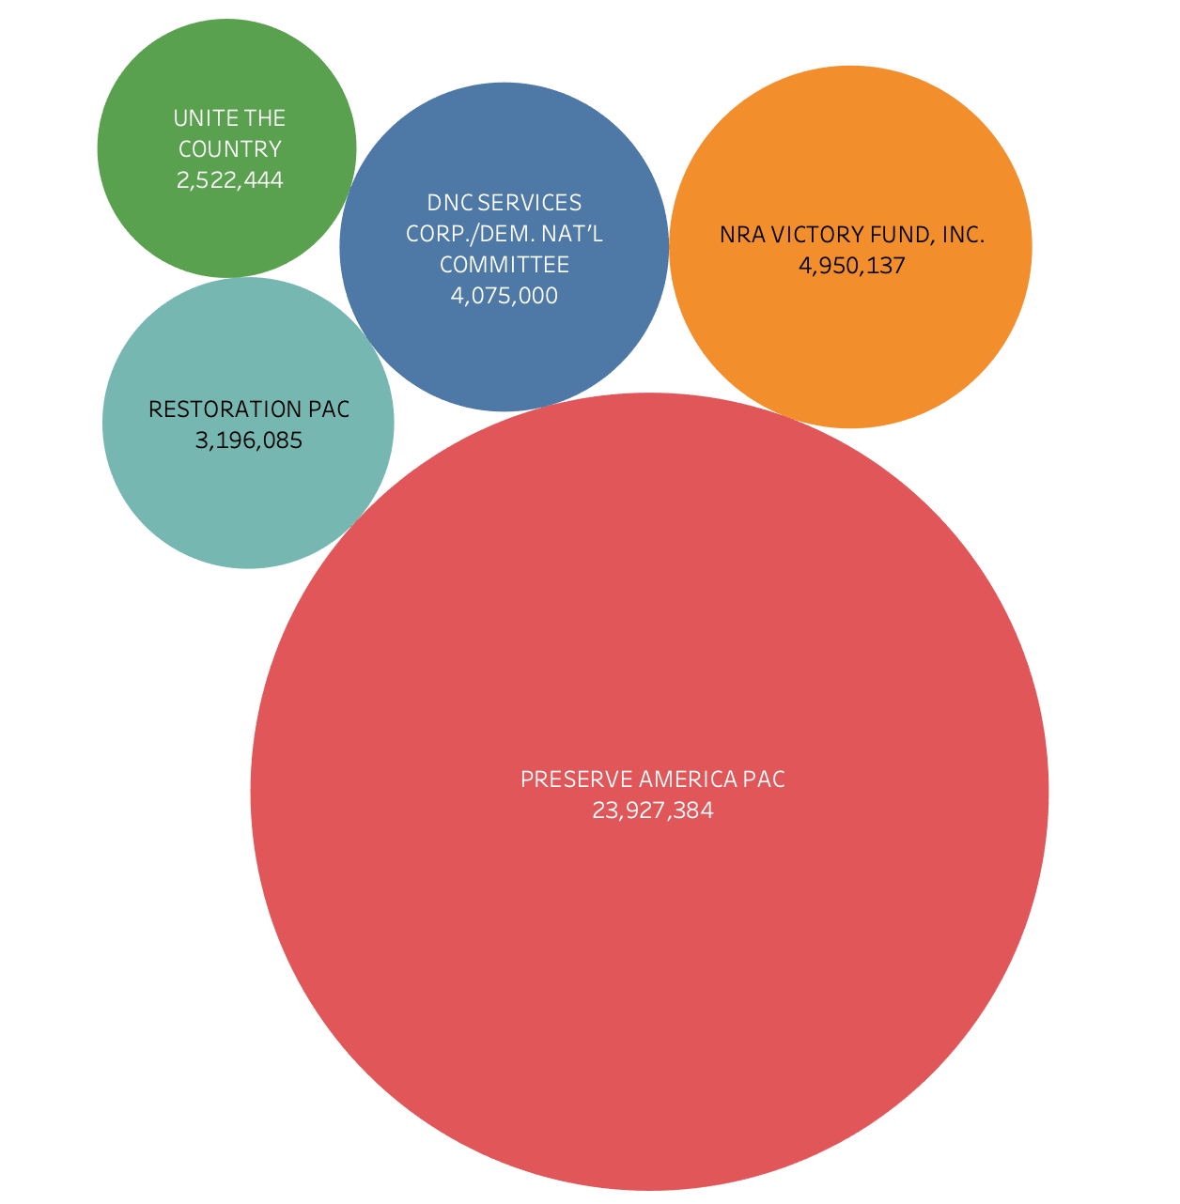
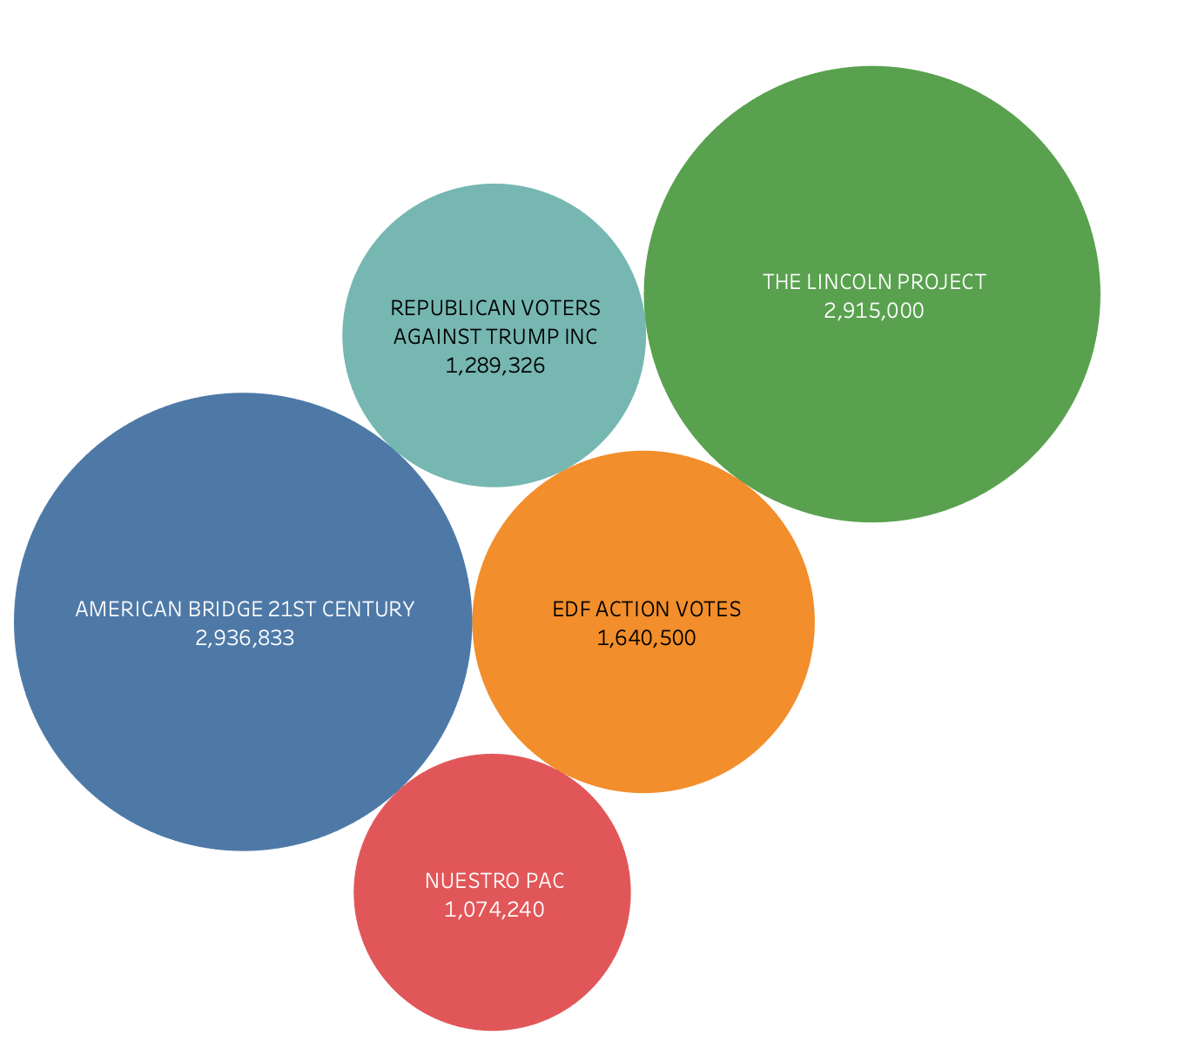
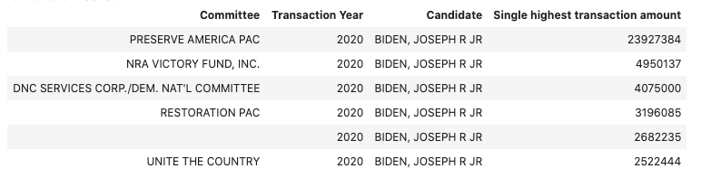
Joe Biden in 2020
Donald Trump in 2020

Slide 9
Analytical Questions and Findings
What are the top 5 candidates from the Democratic party that received the highest amount of total contributions from committees in 2020 and 2016? What are the top 5 candidates from the Republican party that received the highest amount of total contributions from committees in 2020 and 2016?

Slide 10
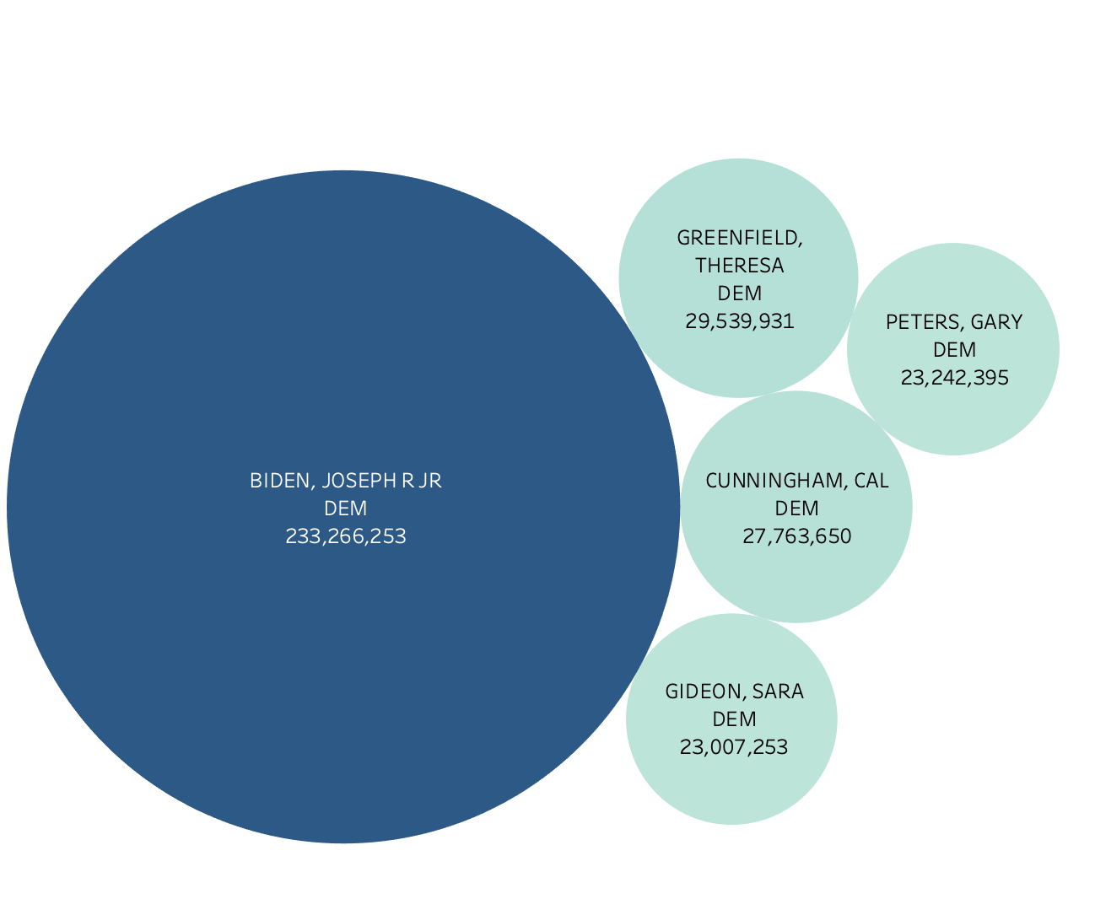
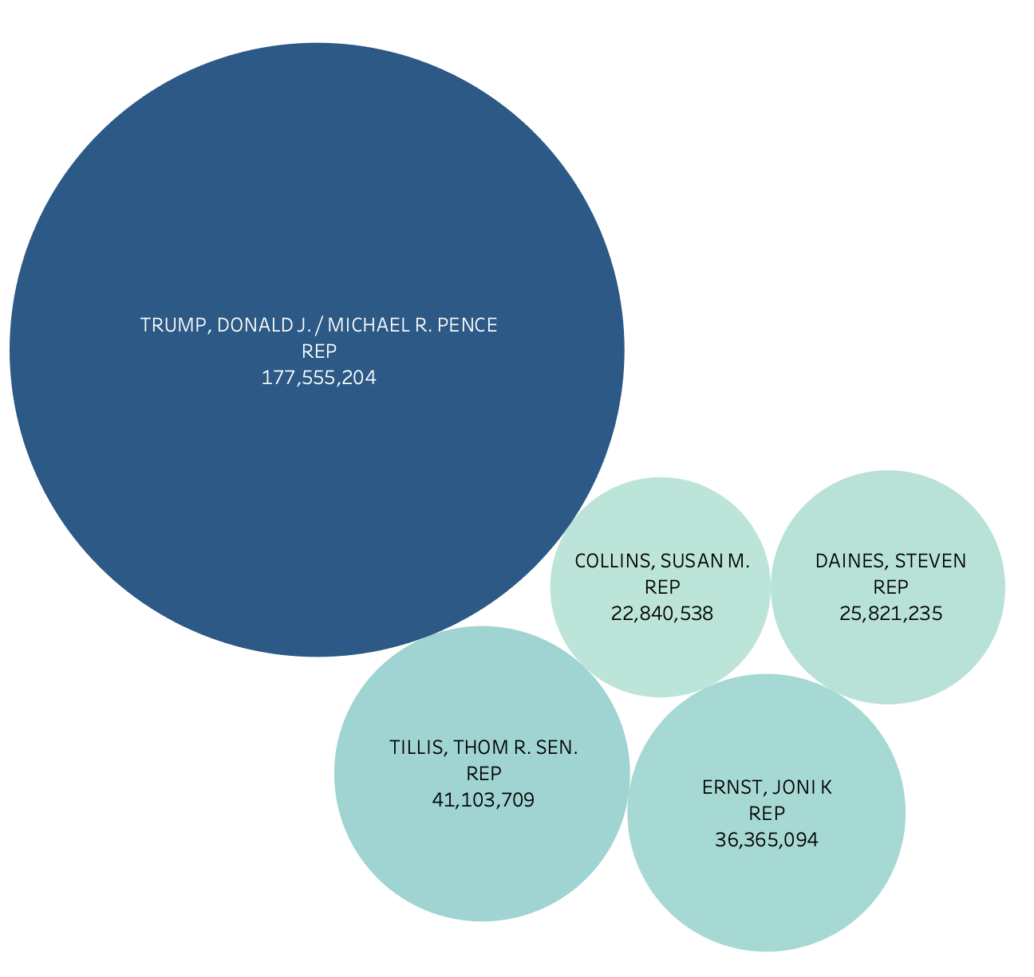
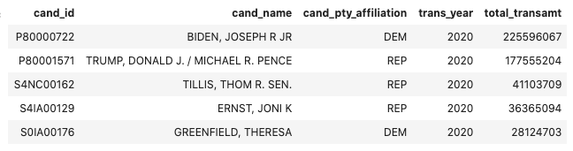
Democrats
2020
Republicans

Slide 11
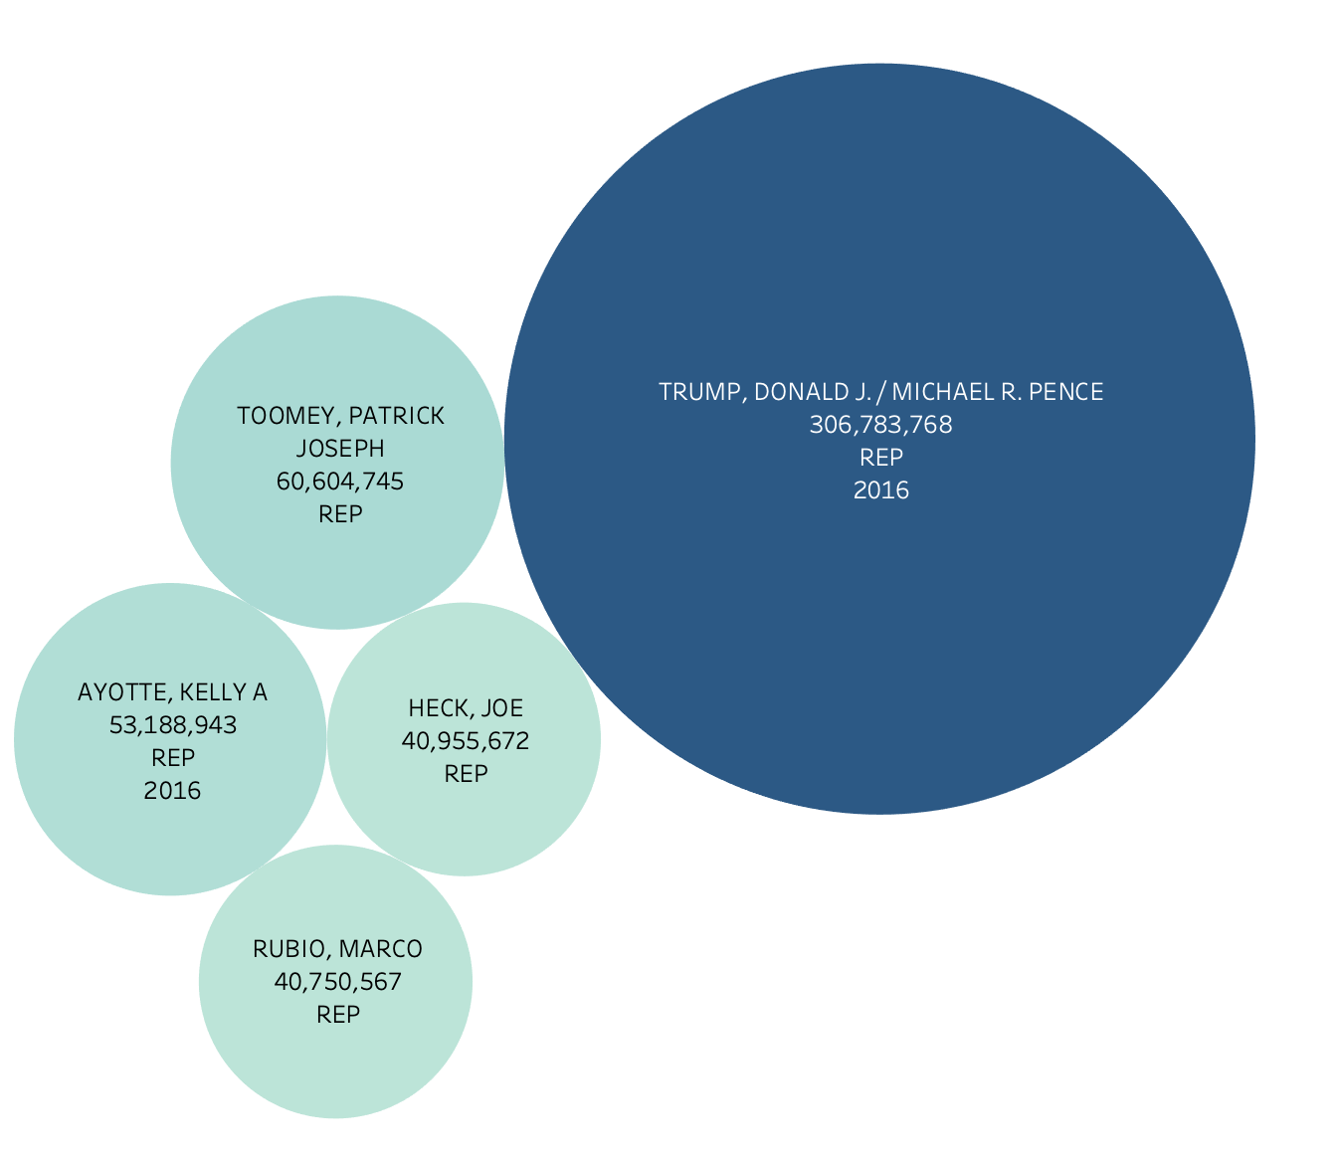
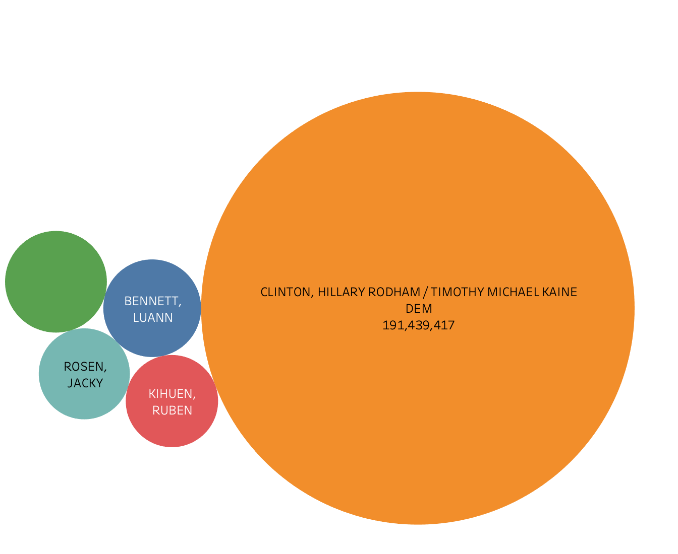
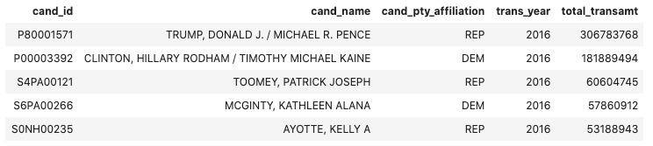
Democrats
2016
Republicans

Slide 12
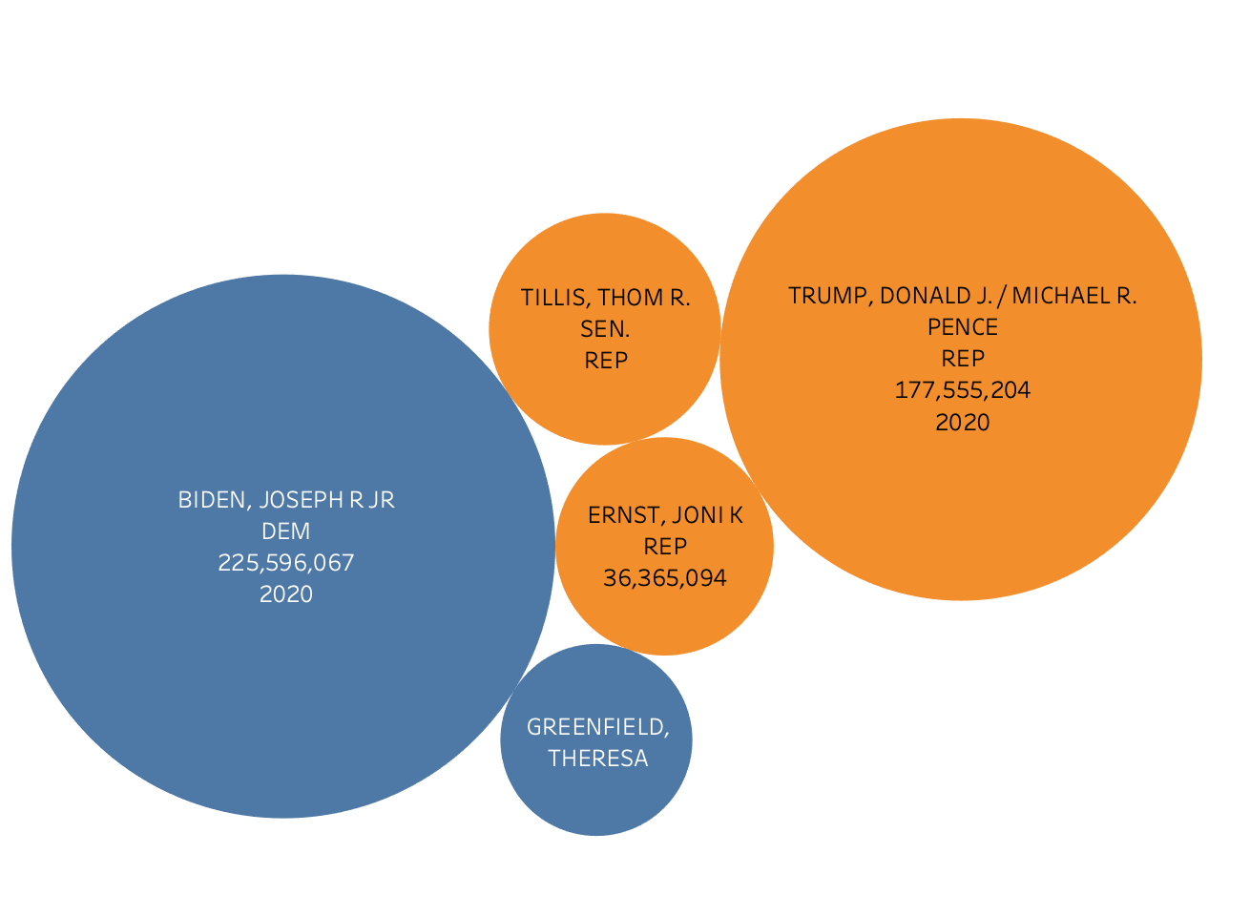
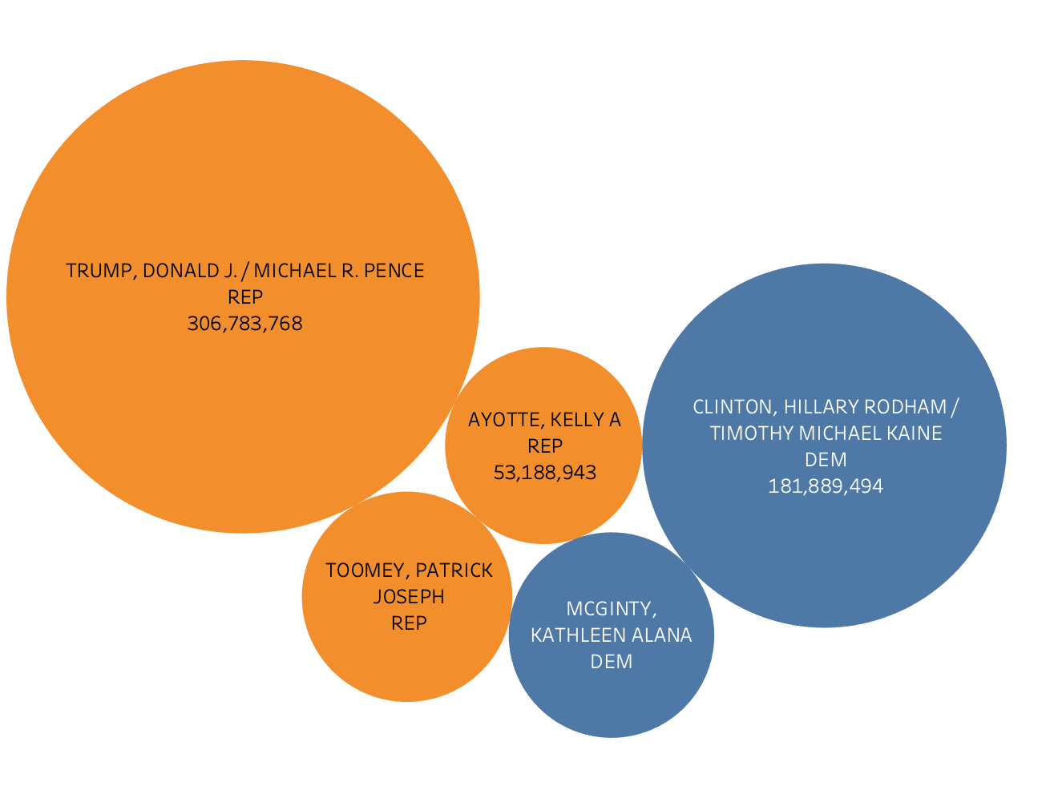

2020
2016

Slide 13
Analytical Questions and Findings
Which state contributed the most to Joe Biden, and which state contributed the most to Donald Trump in 2020?

Slide 14
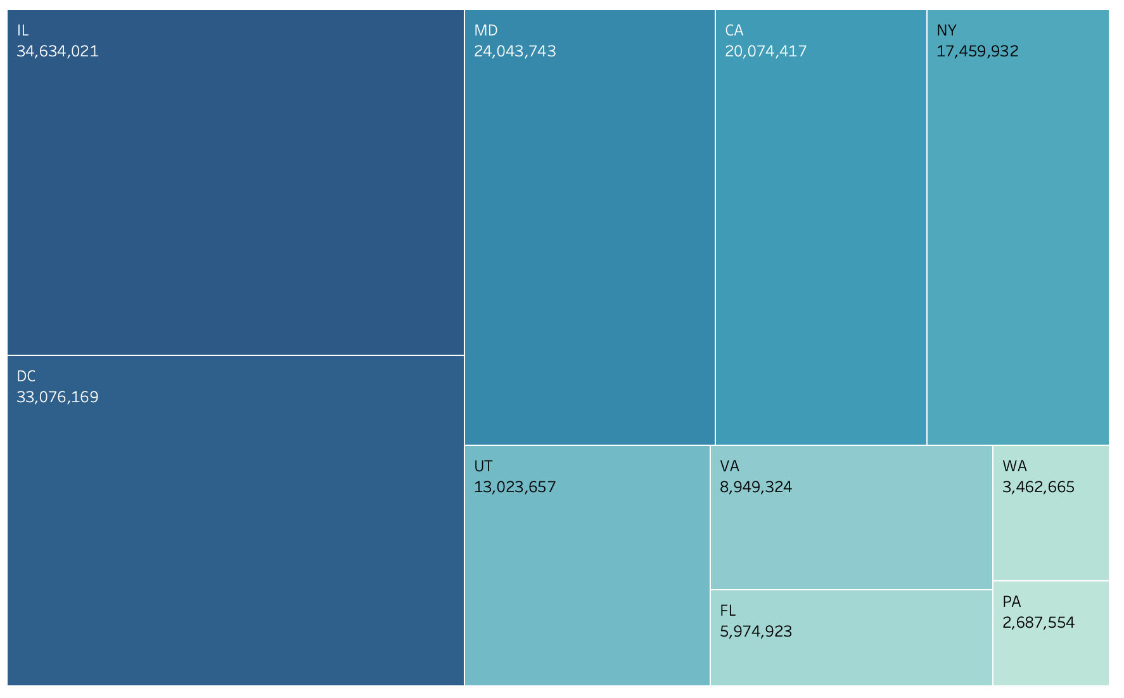
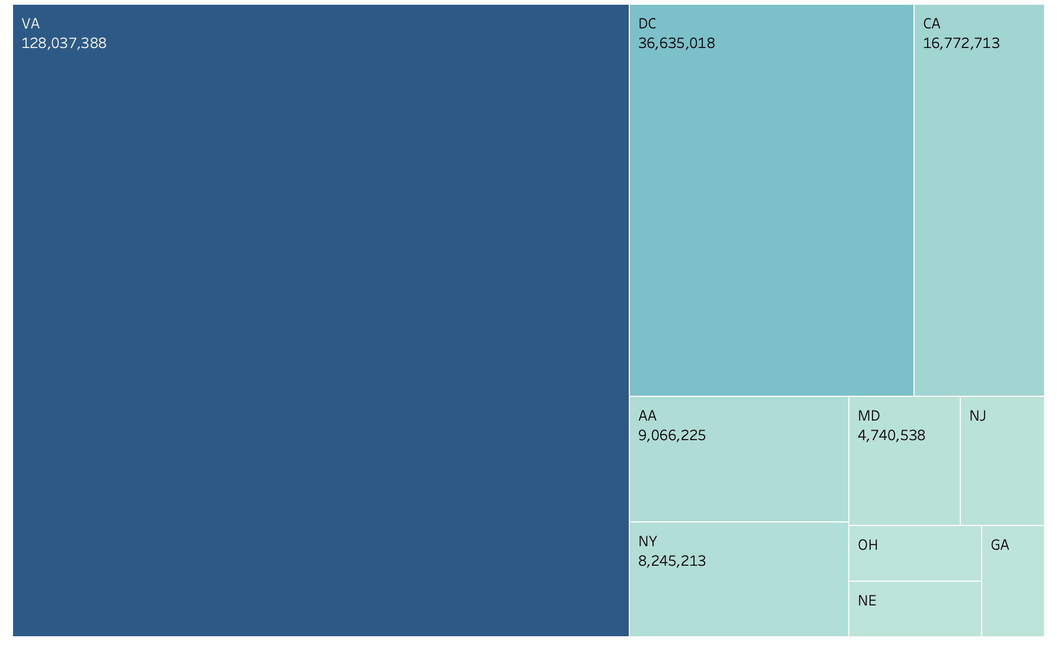
Democrats
Republicans

Slide 15
THANK YOU !

